Slide 1
HTTP and REST
Lecture 3

Slide 2
What is Web Service?
A method of communication between two machines over a network.
Web services are application programming interfaces (API) that are typically accessed via HTTP protocol and executed on a remote server.
Two major types of Web services are:
SOAP-based Web Services
REST-based Web Services

Slide 3
What is REST?
Representational state transfer (REST) is a style of software architecture for distributed hypermedia systems such as the World Wide Web. (Wikipedia)
REST is coined by Roy Fielding (one of the principle authors of the HTTP Spec) in his Ph.D dissertation in 2000.
Notes:
表现层状态转换

Slide 4
REST Triangle
Nouns (Resources via URI)
Unconstrained
e.g.http://my.api.com/foo
Verbs
Constrained
e.g. GET, POST, DELETE
Content Types
Constrained
e.g. HTML, XML, JSON
src – wikipedia.org
Notes:
URI: Uniform Resource Identifier统一资源标志符

Slide 5
REST Principles
Everything is a resource.
Resources are identified by URI.
Responses are being mapped by HTTP verbs.
One or more representations are identified by media (MIME) types.（pdf， json， audio， same api, same resources, different representations）
Hypermedia as the Engine of Application State (HATEOAS)--responses can have hypermedia links to further resources.
Works for any client that can speak HTTP.

Slide 6
REST Constraints
Client-sever
Stateless
Cacheable可缓冲
Layered system
Uniform interface统一界面
Code on Demand
Notes:
2. the server does not store any state about the client session on the server-side.

Slide 7
1. Client-server
A clear “separation of concerns” by dividing responsibilities between clients and servers.
Clients are not concerned with activities like storing resource data on servers.
Servers are not responsible for maintained clients’ state.

Slide 8
2. Stateless
In order to minimize coupling and improve scalability, servers should be “stateless”.
Session state is maintained on the client and no user-specific information is stored on the sever.
Every request must contain all of the information required to satisfy the request.
Notes:
minimize coupling减少耦合
improve scalability 提高可扩展性
https://requestbin.com/r/en01j2zsw7no87
su@SUs-MacBook-Pro ~ % get http://useradata.ca/user/1
zsh: command not found: get
su@SUs-MacBook-Pro ~ % curl -i https://en01j2zsw7no87.x.pipedream.net/
HTTP/1.1 200 OK
Access-Control-Allow-Origin: *
Content-Type: application/json; charset=utf-8
Date: Wed, 16 Sep 2020 05:02:06 GMT
x-pd-status: sent to primary
X-Powered-By: Express
Content-Length: 16
Connection: keep-alive
{"success":true}%
su@SUs-MacBook-Pro ~ % curl -i https://en01j2zsw7no87.x.pipedream.net/
HTTP/1.1 200 OK
Access-Control-Allow-Origin: *
Content-Type: application/json; charset=utf-8
Date: Wed, 16 Sep 2020 05:02:16 GMT
x-pd-status: sent to primary
X-Powered-By: Express
Content-Length: 16
Connection: keep-alive

Slide 9
3. Cacheable
To improve scalability and performance, REST clients and network intermediaries are allowed to cache responses.
Server responses should indicate whether or not they are cacheable and for how long.
Notes:
Scalability:可扩展性
Intermediary: 中介

Slide 10
4. Layered system
Like WWW, RESTful services support routing requests through network intermediaries during transit to the destination server.
These intermediaries can add value such as load balancing or local caching to further improve scalability and performance.

Slide 11
5. Uniform interface
A uniform interface specifies the standard by which REST clients and servers communicate.
This allows each side to evolve independently and simplifies re-use.

Slide 12
6. Code on Demand
The server can return business logic code that will be executed on the client.
E.g. Client-side JavaScript, JSONP, and Flash applications.

Slide 13
Resource Design (Nouns)
How should a real data set be represented in resources?
/customers/{customer_id}
/customers/{customer_id}/orders
/customers/{customer_id}/orders/{order_id}
/orders/{order_id}
/orders
/orders/recent
/orders/canceled
E.g. http://my.api.com/customers/123

Slide 14
Noun OR Nouns
Singular
/customer/{customer_id}
/customer/{customer_id}/order
/customer/{customer_id}/order/{order_id}
Plural (we’ll use plural for the class)
/customers/{customer_id}
/customers/{customer_id}/orders
/customers/{customer_id}/orders/{order_id}
Notes:
Plural 复数形式

Slide 15
Representation Design
What data format the client wants to accept from the resources?
Plain Text, HTML, XML, JSON, Atom, CSV, PDF,…
Media types/MIME types (text/xml, text/json,…)
Link this Resource to existing resources (Relationship between resources)

Slide 16
Uniform Interface using HTTP VERB
GET
POST
PUT
DELETE
HEAD
OPTIONS

Slide 17
Operation Mapping
HTTP VERB
POST
GET
PUT
DELETE
CRUD (Application operations)
CREATE
READ
UPDATE
DELETE

Slide 18
GET
GET retrieves a representation of a resource from a server.
Based on the request Accept header, the server decides what kind of representation (content-type) to return.
The server returns HTTP 200 for a successful response.
GET is repeatable.

Slide 19
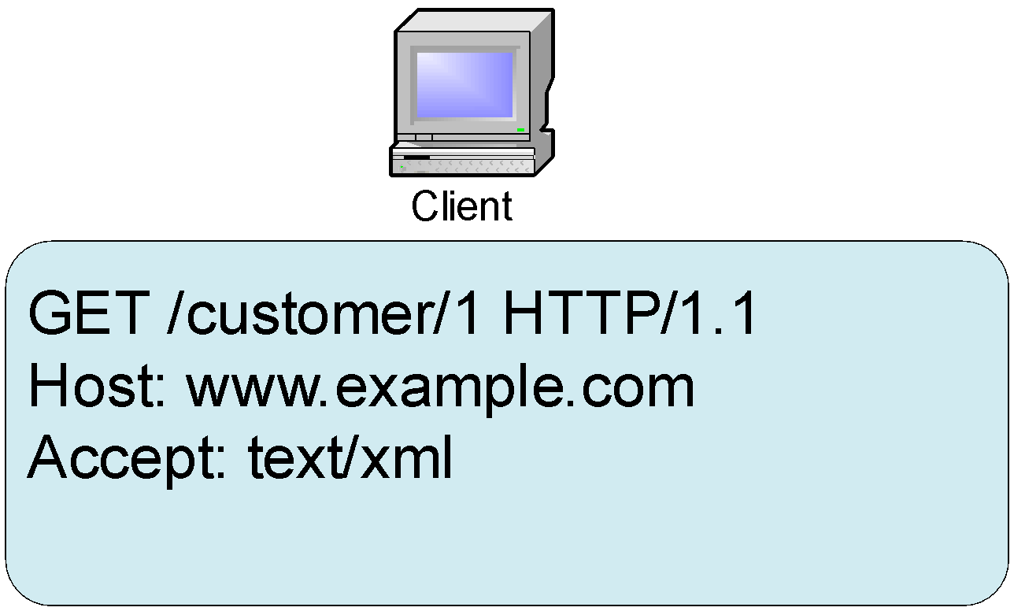

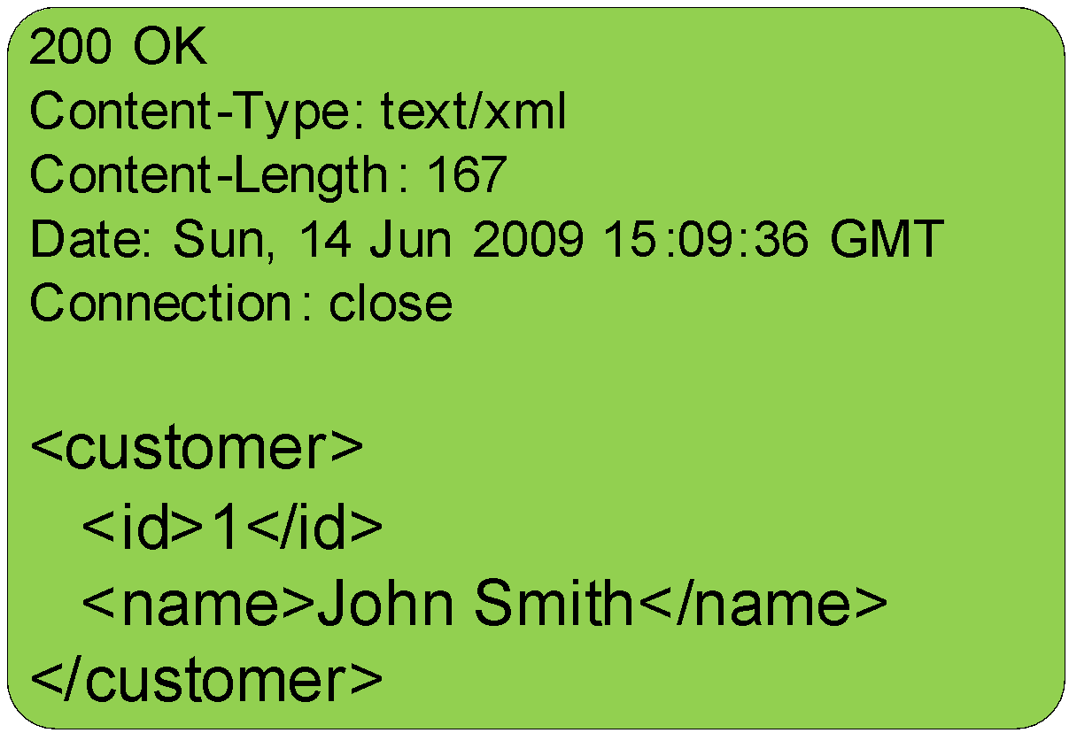
GET Example
Request
Response
Notes:
Connection can also be keep-alive
su@SUs-MacBook-Pro ~ % curl -i https://en01j2zsw7no87.x.pipedream.net/
HTTP/1.1 200 OK // 1.1 : version
Access-Control-Allow-Origin: *// take request from anywhere in the world, if we don’t have it , the call can only from certain domain
Content-Type: application/json; charset=utf-8 //allow your to do different langauges
Date: Wed, 16 Sep 2020 05:02:16 GMT
x-pd-status: sent to primary // request goes to primary
X-Powered-By: Express// node.js express framework
Content-Length: 16
Connection: keep-alive

Slide 20
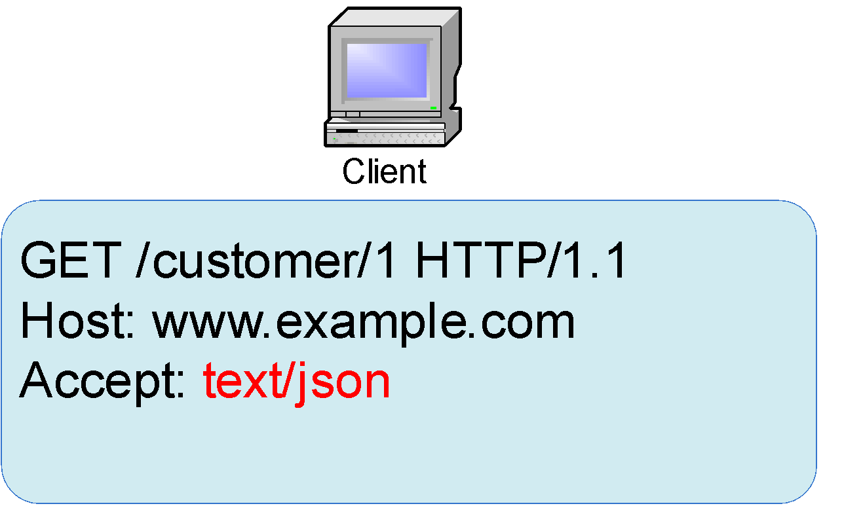
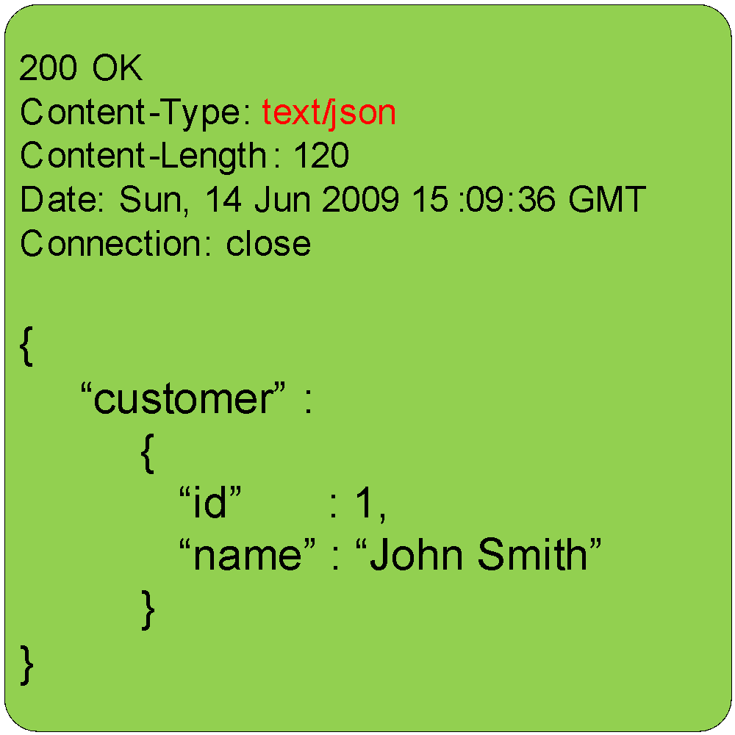
GET Example
Request
Response
Notes:
su@SUs-MacBook-Pro ~ % curl -i -X get https://www.youtube.com/
HTTP/2 405
content-type: text/html; charset=UTF-8
referrer-policy: no-referrer
content-length: 1588
date: Wed, 16 Sep 2020 06:08:01 GMT
alt-svc: h3-29=":443"; ma=2592000,h3-27=":443"; ma=2592000,h3-T051=":443"; ma=2592000,h3-T050=":443"; ma=2592000,h3-Q050=":443"; ma=2592000,h3-Q046=":443"; ma=2592000,h3-Q043=":443"; ma=2592000,quic=":443"; ma=2592000; v="46,43"
<!DOCTYPE html>
<html lang=en>
<meta charset=utf-8>
<meta name=viewport content="initial-scale=1, minimum-scale=1, width=device-width">
<title>Error 405 (Method Not Allowed)!!1</title>
<style>
*{margin:0;padding:0}html,code{font:15px/22px arial,sans-serif}html{background:#fff;color:#222;padding:15px}body{margin:7% auto 0;max-width:390px;min-height:180px;padding:30px 0 15px}* > body{background:url(//www.google.com/images/errors/robot.png) 100% 5px no-repeat;padding-right:205px}p{margin:11px 0 22px;overflow:hidden}ins{color:#777;text-decoration:none}a img{border:0}@media screen and (max-width:772px){body{background:none;margin-top:0;max-width:none;padding-right:0}}#logo{background:url(//www.google.com/images/branding/googlelogo/1x/googlelogo_color_150x54dp.png) no-repeat;margin-left:-5px}@media only screen and (min-resolution:192dpi){#logo{background:url(//www.google.com/images/branding/googlelogo/2x/googlelogo_color_150x54dp.png) no-repeat 0% 0%/100% 100%;-moz-border-image:url(//www.google.com/images/branding/googlelogo/2x/googlelogo_color_150x54dp.png) 0}}@media only screen and (-webkit-min-device-pixel-ratio:2){#logo{background:url(//www.google.com/images/branding/googlelogo/2x/googlelogo_color_150x54dp.png) no-repeat;-webkit-background-size:100% 100%}}#logo{display:inline-block;height:54px;width:150px}
</style>
<a href=//www.google.com/><span id=logo aria-label=Google></span></a>
<p><b>405.</b> <ins>That’s an error.</ins>
<p>The request method <code>get</code> is inappropriate for the URL <code>/</code>. <ins>That’s all we know.</ins>

Slide 21
HEAD
Same as GET with no body in the response.
Useful for looking up resources, data size, and content type before GETing actual resources.
Notes:
su@SUs-MacBook-Pro ~ % curl -i -X HEAD https://www.youtube.com/
Warning: Setting custom HTTP method to HEAD with -X/--request may not work the
Warning: way you want. Consider using -I/--head instead.
HTTP/2 200
strict-transport-security: max-age=31536000
p3p: CP="This is not a P3P policy! See http://support.google.com/accounts/answer/151657?hl=en for more info."
x-content-type-options: nosniff
expires: Tue, 27 Apr 1971 19:44:06 GMT
cache-control: no-cache
x-frame-options: SAMEORIGIN
content-type: text/html; charset=utf-8
date: Wed, 16 Sep 2020 06:06:55 GMT
server: YouTube Frontend Proxy
x-xss-protection: 0
set-cookie: VISITOR_INFO1_LIVE=7hWHz82iZc8; path=/; domain=.youtube.com; secure; expires=Mon, 15-Mar-2021 06:06:55 GMT; httponly; samesite=None
set-cookie: GPS=1; path=/; domain=.youtube.com; expires=Wed, 16-Sep-2020 06:36:55 GMT
set-cookie: YSC=n7zcnCHas_w; path=/; domain=.youtube.com; secure; httponly; samesite=None
alt-svc: h3-Q050=":443"; ma=2592000,h3-29=":443"; ma=2592000,h3-27=":443"; ma=2592000,h3-T051=":443"; ma=2592000,h3-T050=":443"; ma=2592000,h3-Q046=":443"; ma=2592000,h3-Q043=":443"; ma=2592000,quic=":443"; ma=2592000; v="46,43"
accept-ranges: none
vary: Accept-Encoding. //
su@SUs-MacBook-Pro ~ % curl -I -X HEAD https://www.youtube.com/
HTTP/2 200
x-frame-options: SAMEORIGIN
x-content-type-options: nosniff
cache-control: no-cache
strict-transport-security: max-age=31536000
content-type: text/html; charset=utf-8
expires: Tue, 27 Apr 1971 19:44:06 GMT
p3p: CP="This is not a P3P policy! See http://support.google.com/accounts/answer/151657?hl=en for more info."
date: Wed, 16 Sep 2020 06:09:55 GMT
server: YouTube Frontend Proxy
x-xss-protection: 0
set-cookie: VISITOR_INFO1_LIVE=BKLssttPWaY; path=/; domain=.youtube.com; secure; expires=Mon, 15-Mar-2021 06:09:55 GMT; httponly; samesite=None
set-cookie: GPS=1; path=/; domain=.youtube.com; expires=Wed, 16-Sep-2020 06:39:55 GMT
set-cookie: YSC=q0phLa2ZjpI; path=/; domain=.youtube.com; secure; httponly; samesite=None
alt-svc: h3-29=":443"; ma=2592000,h3-27=":443"; ma=2592000,h3-T051=":443"; ma=2592000,h3-T050=":443"; ma=2592000,h3-Q050=":443"; ma=2592000,h3-Q046=":443"; ma=2592000,h3-Q043=":443"; ma=2592000,quic=":443"; ma=2592000; v="46,43"
accept-ranges: none
vary: Accept-Encoding

Slide 22

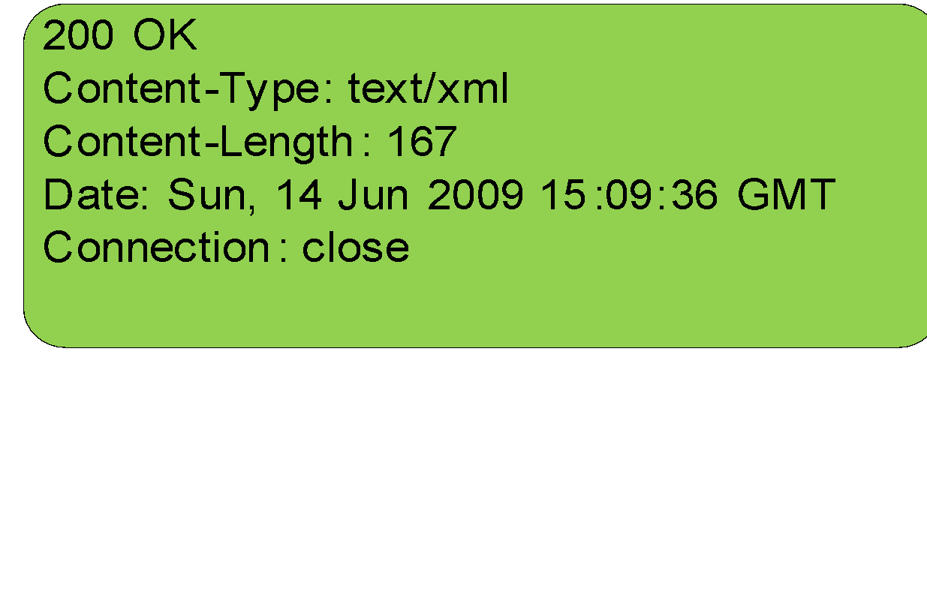
HEAD Example
Request
Response

Slide 23
POST
POST creates a new resource on a server.
Sends the new resource in the request body.
The server chooses a URI for the new resource and sends it back to the client in the response header (Location).
Successful POST response typically has empty body.
The server returns HTTP 201 (Created) for a successful response.

Slide 24

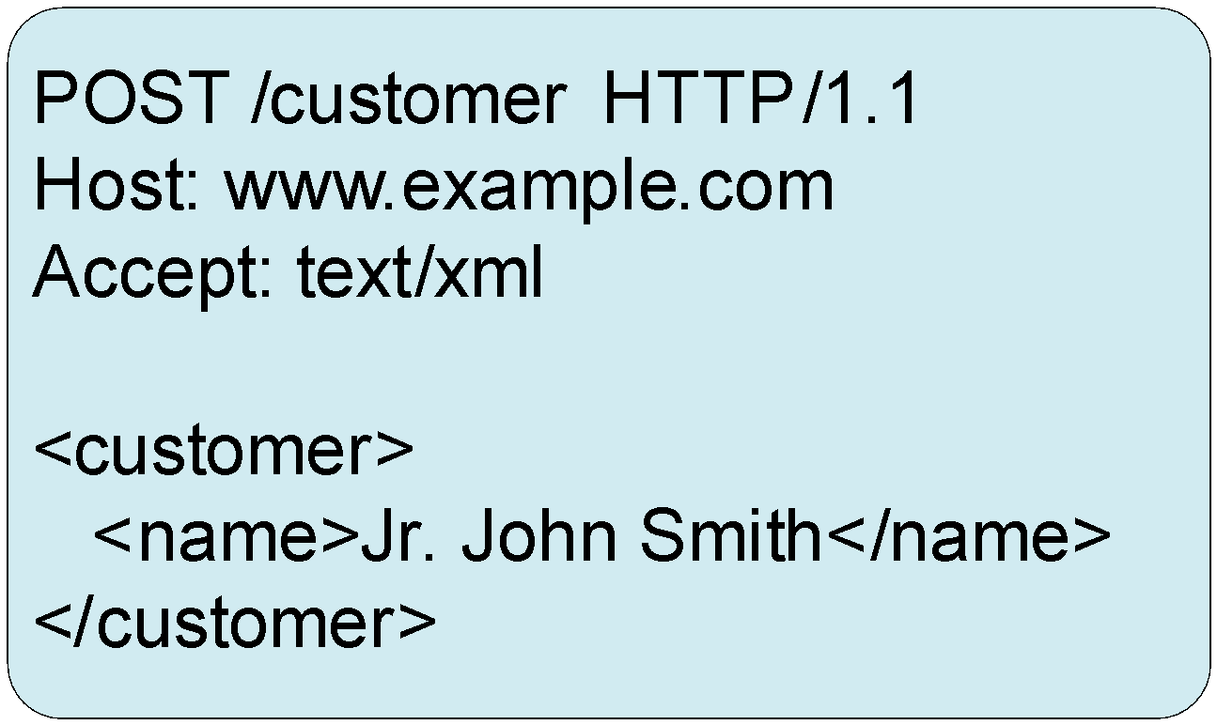
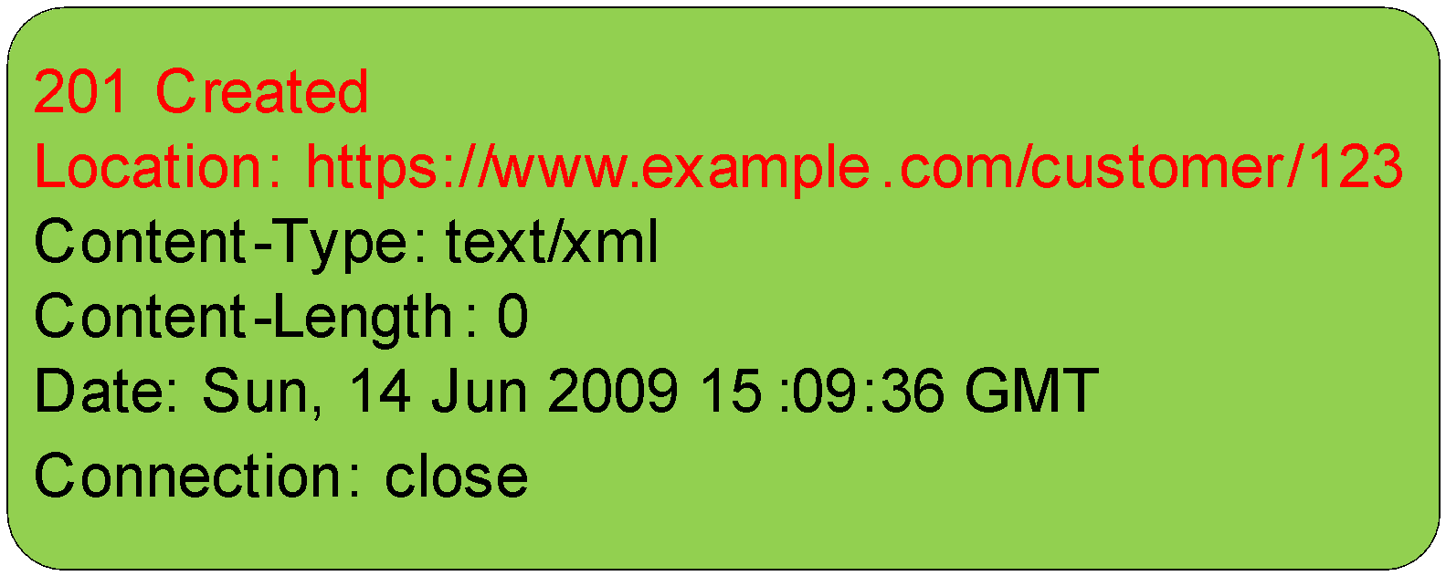
POST Example
Request
Response
Notes:
su@SUs-MacBook-Pro ~ % curl -I -X POST '{ "name": "Darth Vader" }' \
-H "Content-Type: application/json" \
https://en01j2zsw7no87.x.pipedream.net/
curl: (3) URL using bad/illegal format or missing URL
HTTP/1.1 200 OK
Access-Control-Allow-Origin: *
Content-Type: application/json; charset=utf-8
Date: Wed, 16 Sep 2020 06:20:07 GMT
x-pd-status: sent to primary
X-Powered-By: Express
Content-Length: 16
Connection: keep-alive

Slide 25
PUT
PUT updates/overwrites an existing resource.
Unlike POST, needs to know the resource URI.
Request is the same format as POST.
Idempotent – repeatable.
The server returns HTTP 204 (No Content) with empty body.
Notes:
su@SUs-MacBook-Pro ~ % curl -I -X POST '{ "name": "Darth Vader" }' \
-H "Content-Type: application/json" \
https://en01j2zsw7no87.x.pipedream.net/
curl: (3) URL using bad/illegal format or missing URL
HTTP/1.1 200 OK
Access-Control-Allow-Origin: *
Content-Type: application/json; charset=utf-8
Date: Wed, 16 Sep 2020 06:20:07 GMT
x-pd-status: sent to primary
X-Powered-By: Express
Content-Length: 16
Connection: keep-alive
su@SUs-MacBook-Pro ~ % curl -I -X PUT '{ "name": "Darth Vader" }' \
-H "Content-Type: application/json" \
https://en01j2zsw7no87.x.pipedream.net/
curl: (3) URL using bad/illegal format or missing URL
HTTP/1.1 200 OK
Access-Control-Allow-Origin: *
Content-Type: application/json; charset=utf-8
Date: Wed, 16 Sep 2020 06:21:11 GMT
x-pd-status: sent to primary
X-Powered-By: Express
Content-Length: 16
Connection: keep-alive

Slide 26
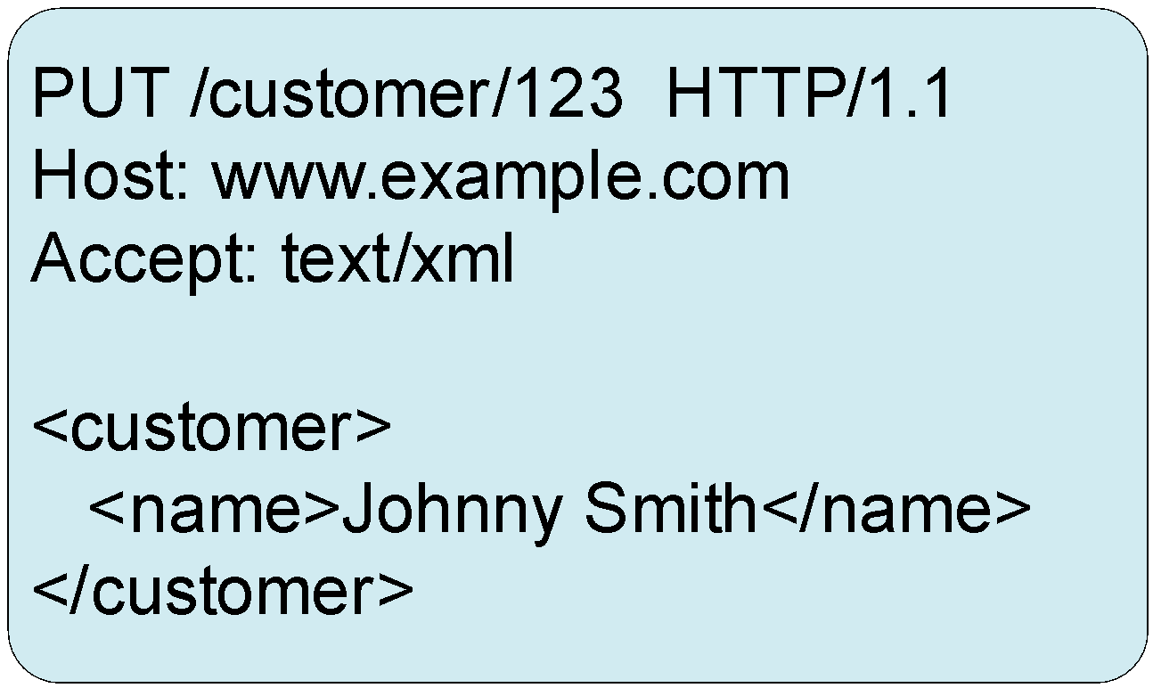
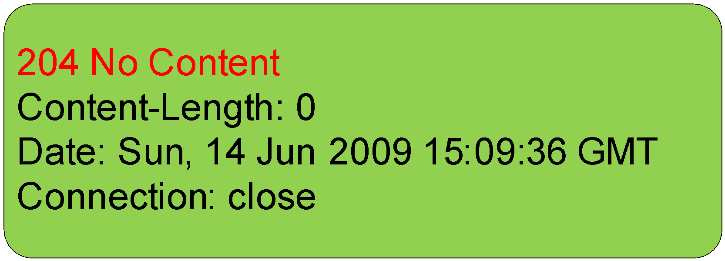
PUT Example
Request
Response

Slide 27
DELETE
DELETE removes a resource from a server.
Idempotent – repeatable.
Notes:
Repeatable means the very first request will be success, the subsequent require will get error,

Slide 28
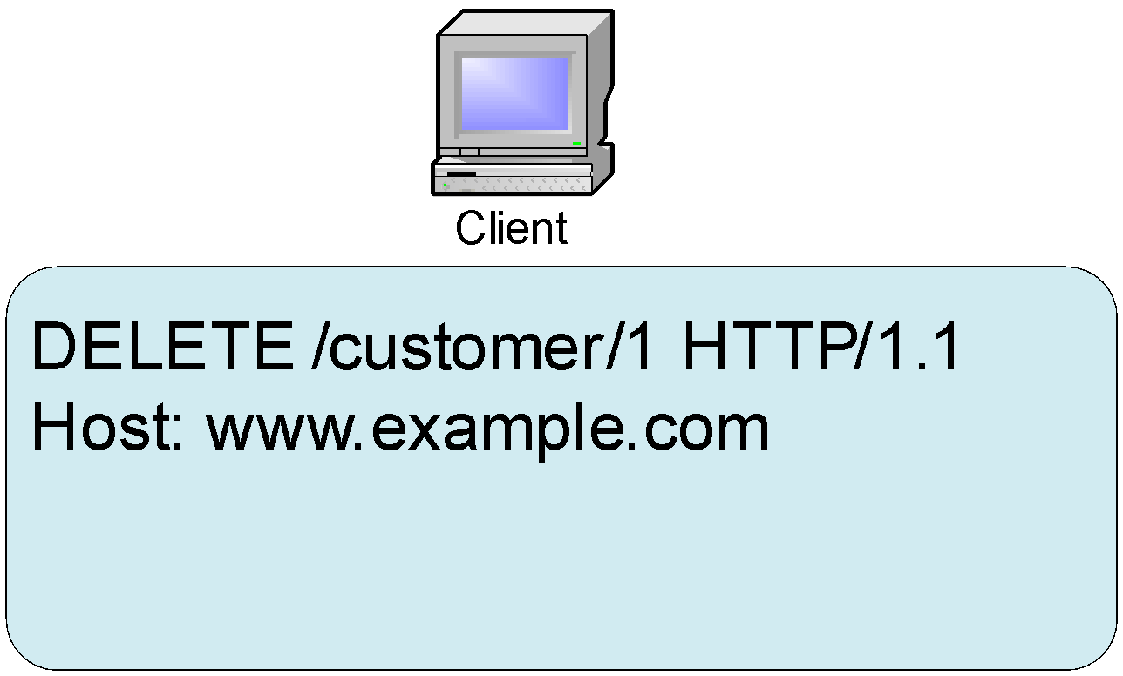
DELETE Example
Request
Response

Slide 29
OPTION
OPTION discovers allowed HTTP methods on a resource.
Idempotent – repeatable.
Notes:
su@SUs-MacBook-Pro ~ % curl -I -X OPTIONS https://www.youtube.com/
HTTP/2 405 // method not allowed
content-type: text/html; charset=UTF-8
referrer-policy: no-referrer
content-length: 1592
date: Wed, 16 Sep 2020 06:27:20 GMT
alt-svc: h3-29=":443"; ma=2592000,h3-27=":443"; ma=2592000,h3-T051=":443"; ma=2592000,h3-T050=":443"; ma=2592000,h3-Q050=":443"; ma=2592000,h3-Q046=":443"; ma=2592000,h3-Q043=":443"; ma=2592000,quic=":443"; ma=2592000; v="46,43"

Slide 30
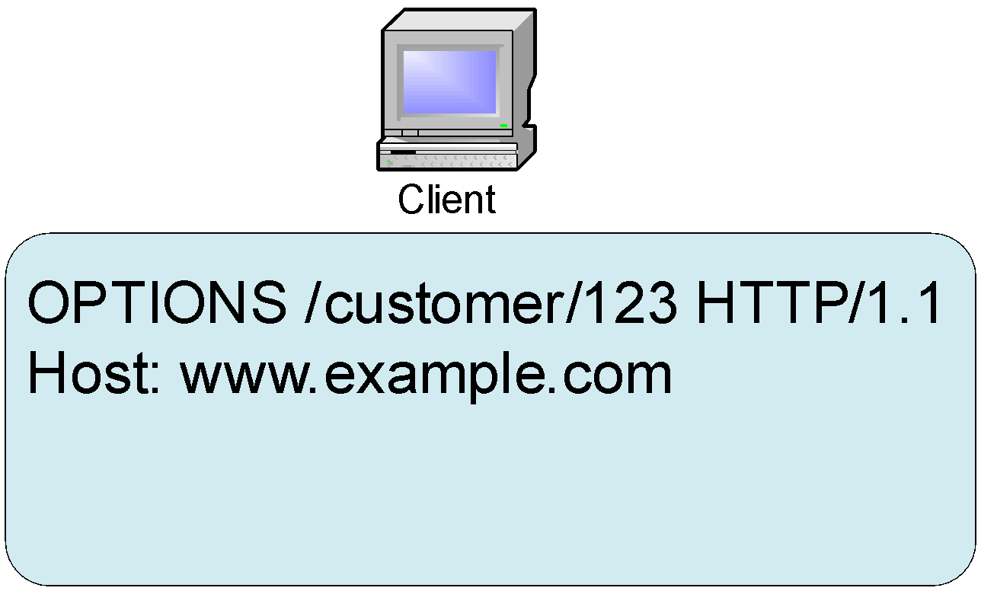
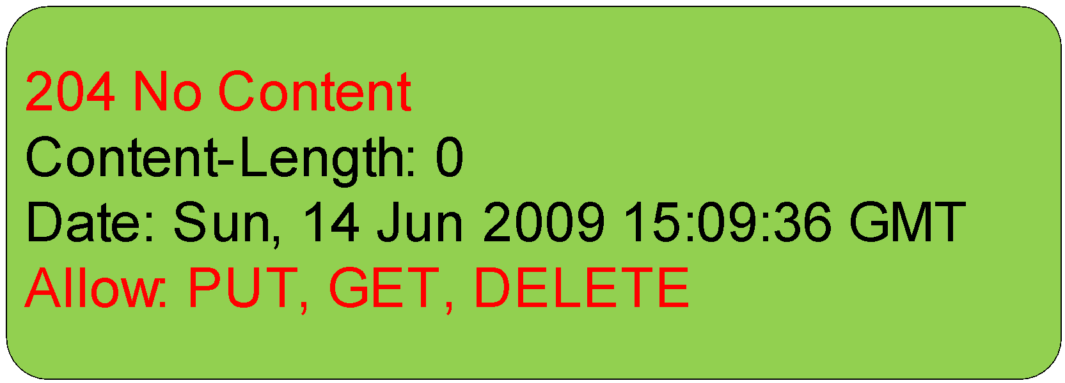
OPTIONS Example
Request
Response

Slide 31
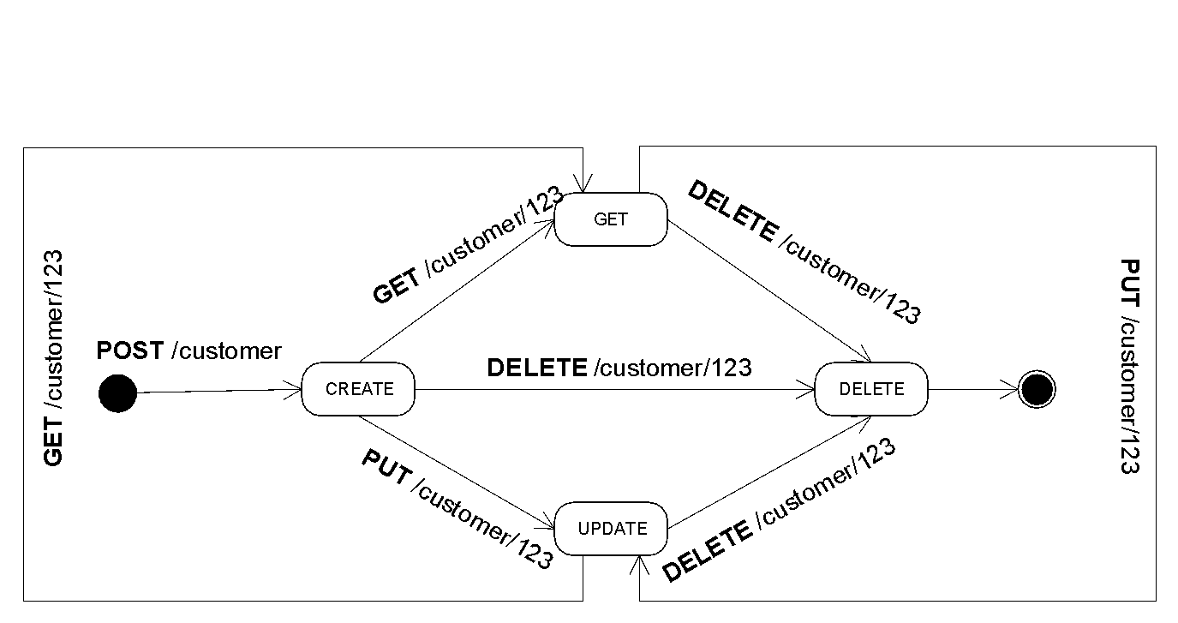
Why is it called Representation State Transfer?

Slide 32
Connectedness - HATOES
Hypermedia is a logical extension of hypertext – video, audio, hyperlinks, and microformats.
Hypermedia are links and forms inside a hypertext representation.
A document contains URI or hyperlink that points to another resource or another possible state of the application.
Notes:
Connectedness连通

Slide 33
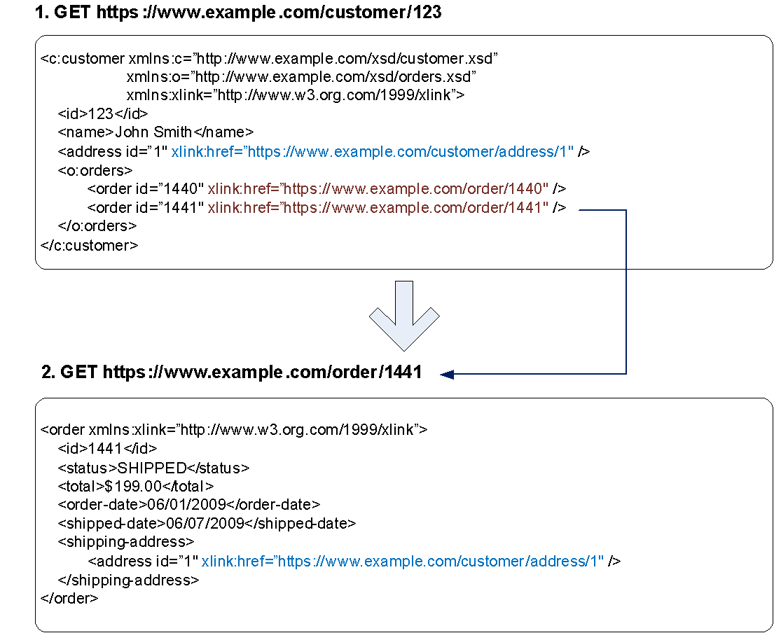
Hyperlinks Example

Slide 34
Conditional GET
Conditional GET allows a server and client to work together to save bandwidth and latency.
The server keeps no application states and does not know when a client last called a particular representation.
But, the server can send Last-Modified timestamp and/or ETag token in the response header to the client.
When the client requests the same representation, it can send timestamp from the prior response in If-Modified-Since and/or ETag token value in If-None-Match header in the request.
The server does not have to return the same representation to the client if the resource has not changed.
In that case, the representation is still fresh, so the server will return HTTP 304 Not Modified header with empty body.
Using ETag is a great match if the server application supports versioning in the data store.
Notes:
ETag是HTTP协议提供的若干机制中的一种Web缓存验证机制，并且允许客户端进行缓存协商。这就使得缓存变得更加高效，而且节省带宽。

Slide 35
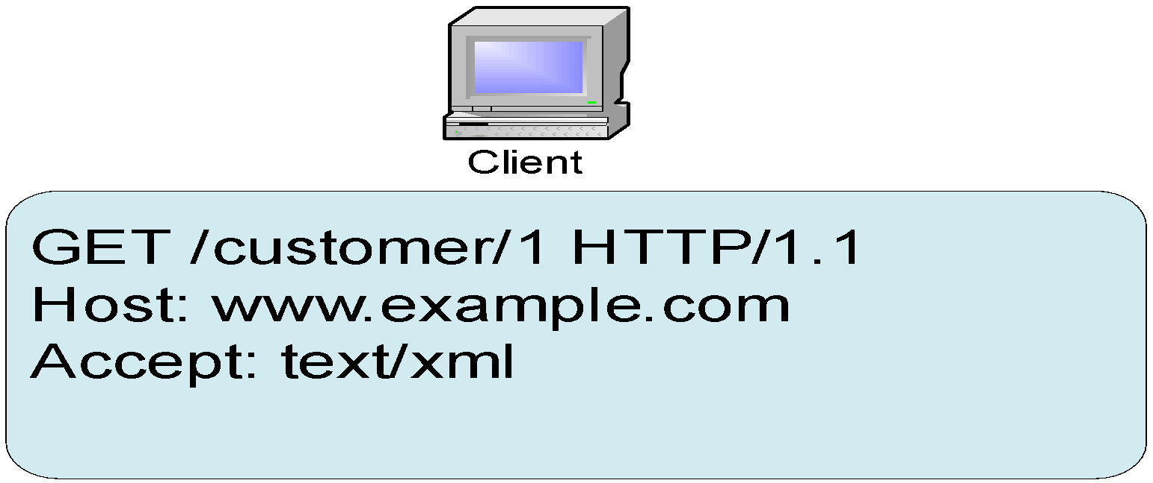

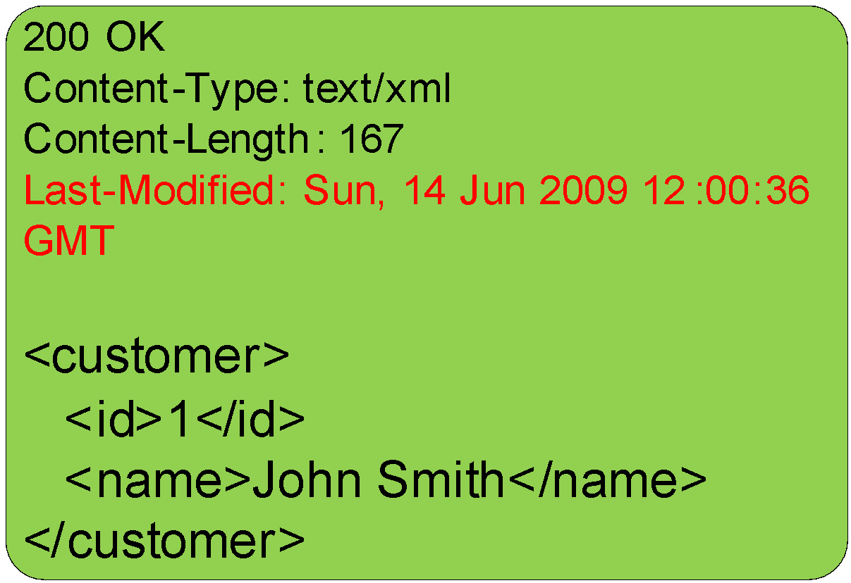
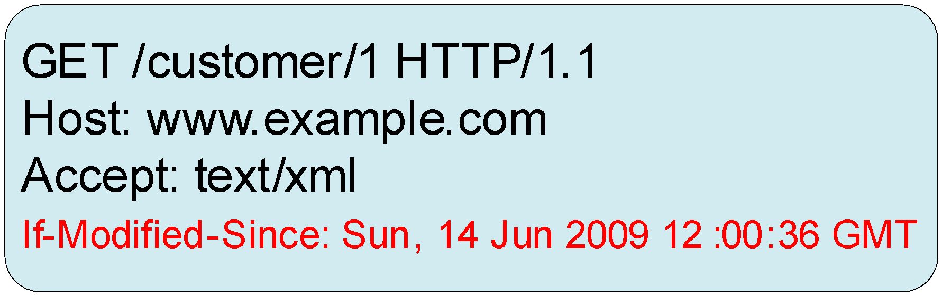
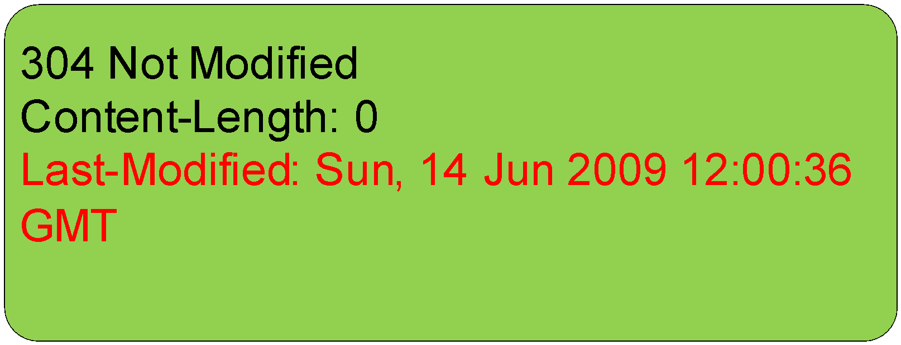
Conditional GET Example
Request 1
Response 1
Request 2
Response 2

Slide 36
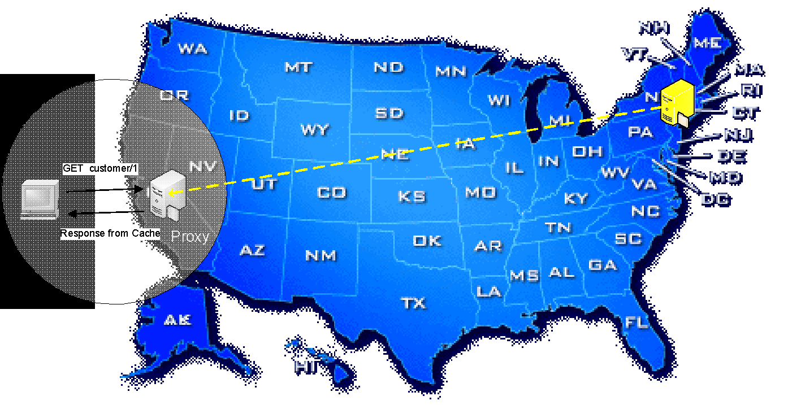
Conditional GET via Proxy Cache

Slide 37
Partial GET
Partial HTTP GET fetches取 only a subset of a representations of a resource.
Sends Range parameter in the request header with byte range (E.g. Range: bytes=100-200)
The server then returns HTTP 206 Partial Content with content range (e.g. Range: bytes=100-200/4000)
Useful for GETing huge static content with a client that supports:
resume interrupted downloads
render content partially while downloading the rest of content bits.
Notes:
When you watch a movie from netflix, u resume the movie, and u want to continue to watch it , you partical get where u stopped, you don’t need to download the data u previous watch

Slide 38
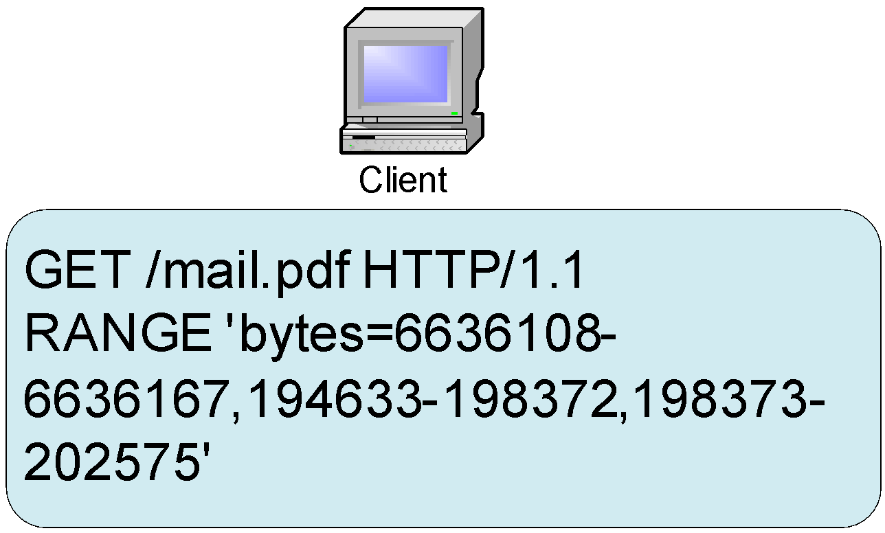
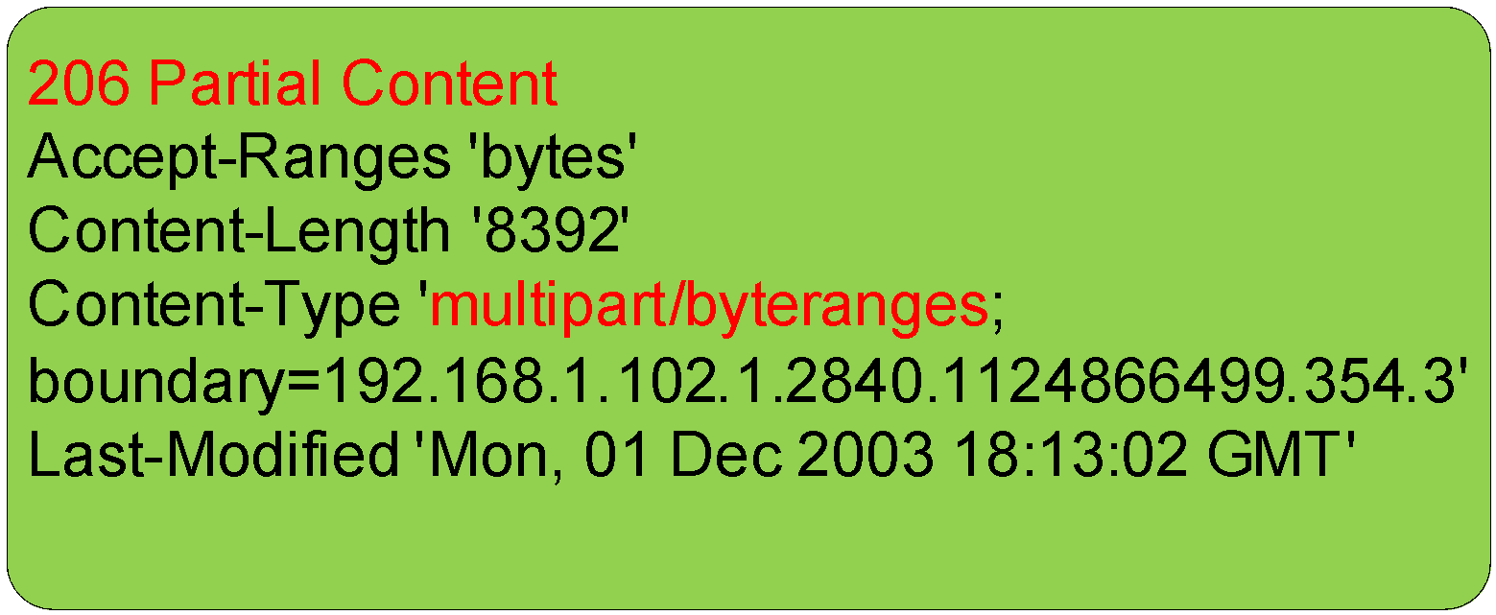
Partial GET Example
Request
Response

Slide 39
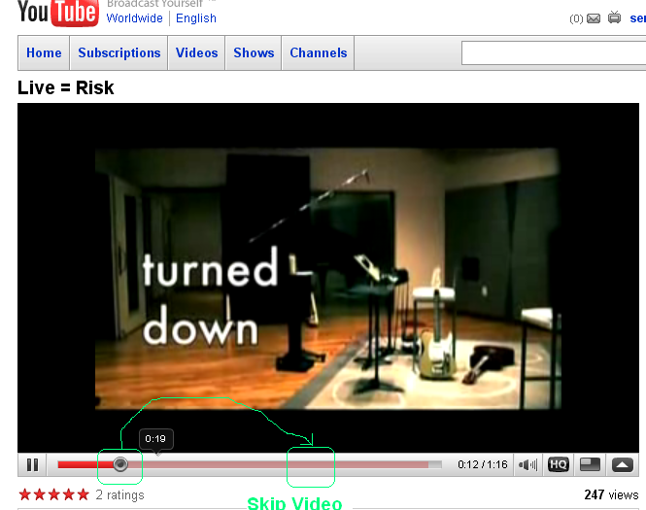

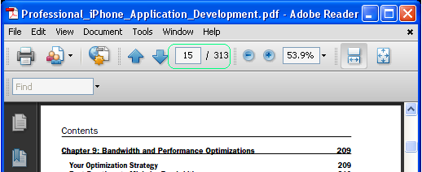
Partial GET Usage
Notes:
You don’t need to render the beginning of the pdf.

Slide 40
Compression压缩
To save bandwidth and get faster response time, text representations like XML, HTML, JSON, and CSV documents can be compressed to a fraction of their original size.
If the client is a browser, compression is already supported with a few configuration on web server.

Slide 41
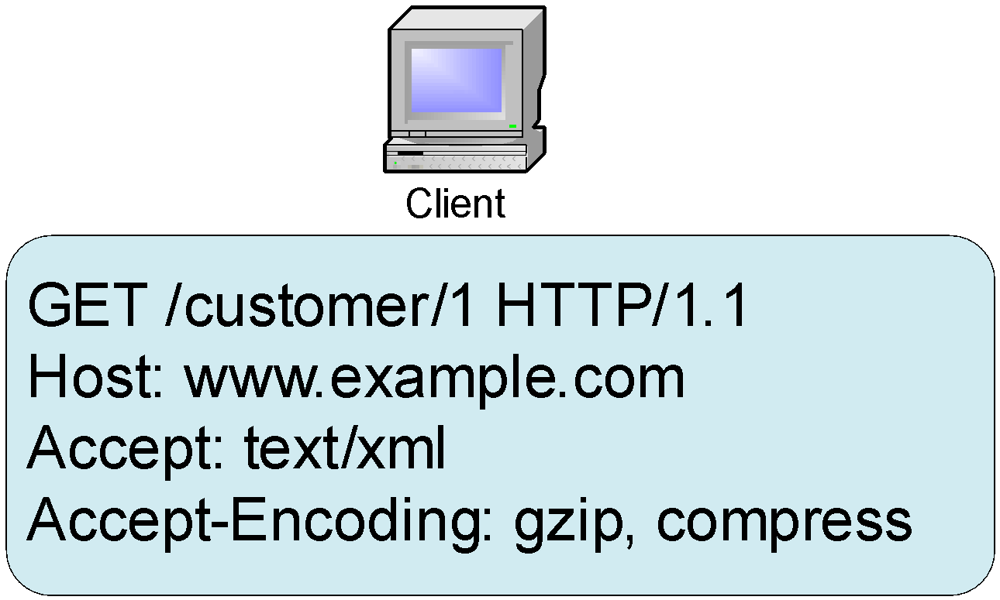
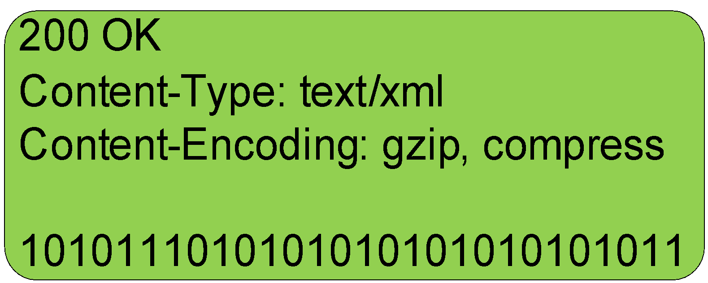
Compression
Request
Response

Slide 42
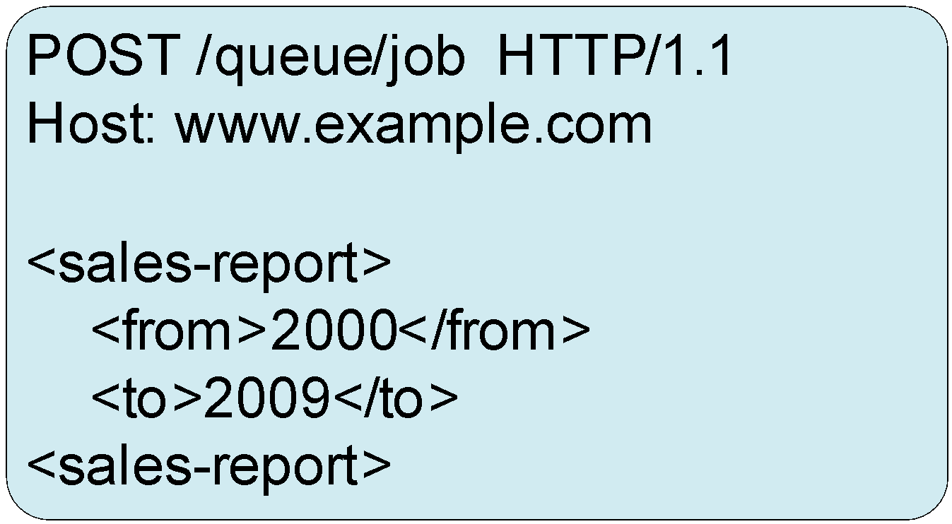
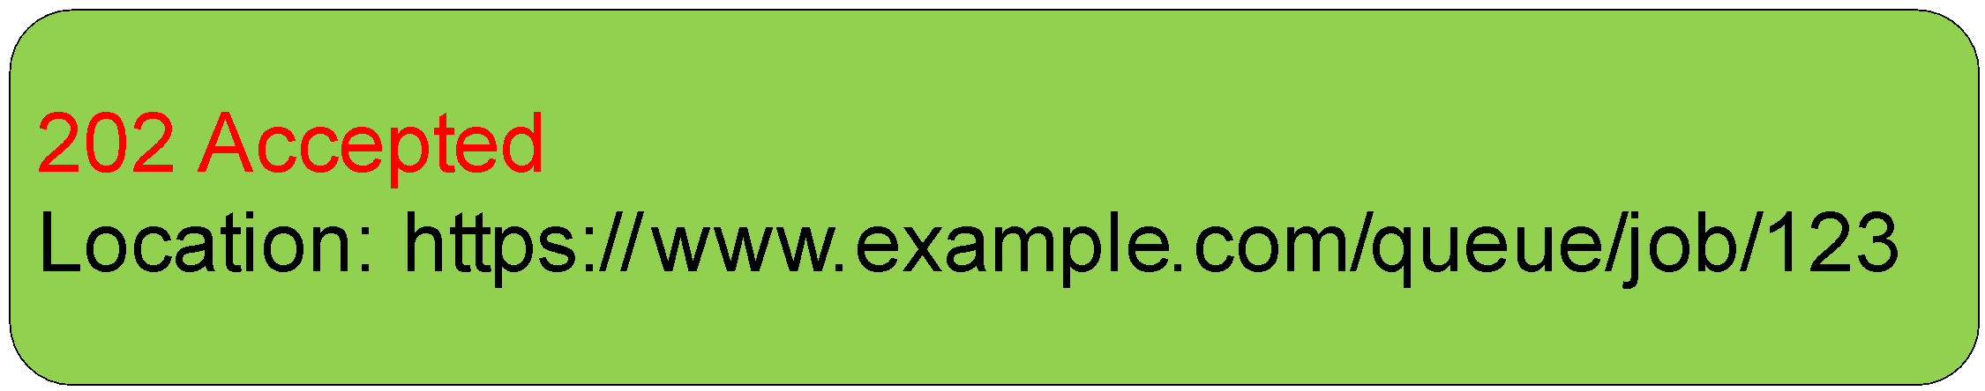
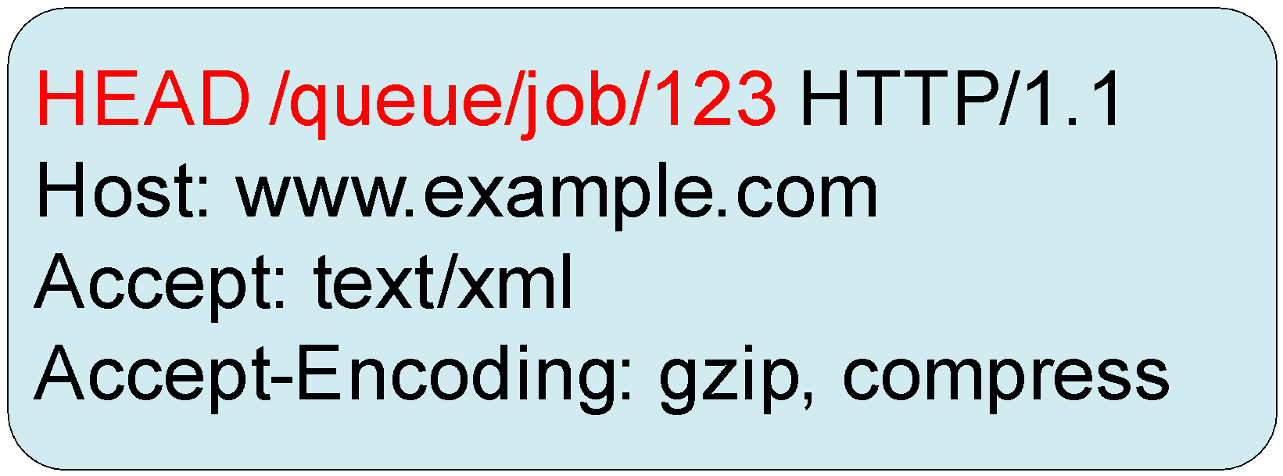
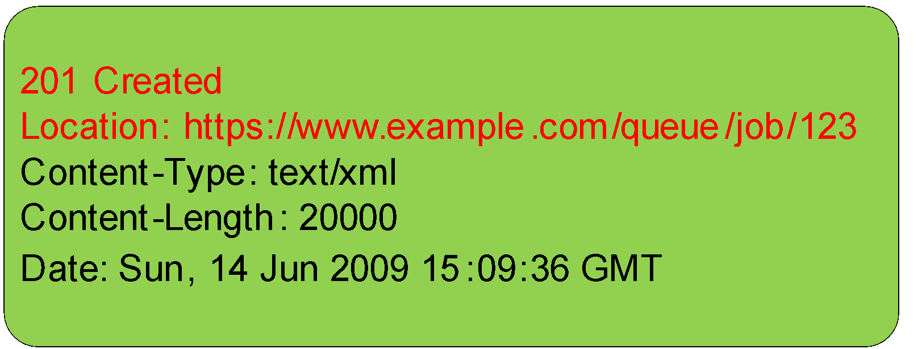
Asynchronous Operations
Request
Response
Request
Response

Slide 43
Batch Operations
A Single HTTP Call
GET - https://www.example.com/customer/1;customer/2;customer/3;customer/4
=
Multiple HTTP Calls
GET - https://www.example.com/customer/1
GET - https://www.example.com/customer/2
GET - https://www.example.com/customer/3
GET - https://www.example.com/customer/4

